Slide 1

PostgreSQL Advanced Level

Slide 2
Agenda
Transactions & Data Consistency
Query Performance & Optimization
Analyzing & Fixing Slow Queries
Cost estimation
Join strategies
Backup & Restore Database
Security - Roles, GRANT & REVOKE
Notes:
2

Slide 3
Transactions & Data Consistency
PostgreSQL ensures data consistency through ACID-compliant transactions and a system called Multi-Version Concurrency Control (MVCC). Transactions guarantee that a series of operations are treated as a single unit of work, either all succeeding or all failing, which prevents the database from entering an invalid state.
ACID Properties
A – Atomicity: All or nothing
C – Consistency: Database moves from one valid state to another
I – Isolation: Concurrent transactions do not interfere
D – Durability: Once committed, data survives crashes
Notes:
3

Slide 4
Transactions & Data Consistency
Transaction Management: PostgreSQL uses specific SQL commands to manage transactions and employs MVCC (Multi-Version Concurrency Control) for efficient, non-locking concurrency.
Commands:
BEGIN or START TRANSACTION: Initiates a transaction block.
COMMIT: Permanently saves all changes made within the transaction.
ROLLBACK: Cancels all changes made in the current transaction, reverting the database to its state before the transaction began.
SAVEPOINT: Sets intermediate rollback points within a transaction for partial rollbacks.
Notes:
4

Slide 5
Transactions & Data Consistency
Isolation Levels: PostgreSQL supports the standard SQL transaction isolation levels, which offer different trade-offs between consistency guarantees and performance:
Read Committed (Default): The most common level. A SELECT query sees a snapshot of the data as it was when that specific query started, preventing "dirty reads" (reading uncommitted data).
Repeatable Read: Provides a stronger guarantee where a single snapshot is used for the entire transaction. This prevents non-repeatable and phantom reads (where a query returns a different set of rows the second time it's run).
Serializable: The strictest level, emulating serial transaction execution. It prevents all concurrency anomalies, including serialization anomalies. If concurrent transactions could produce a result that is impossible in any one-at-a-time execution order, one will be forced to roll back.
Notes:
5

Slide 6
Transactions & Data Consistency
Real-World Examples
Banking / Wallet System: Transferring money between two accounts—debit and credit must either both succeed or both fail.
Order Processing System: Create order → reserve inventory → generate invoice → payment fails → ROLLBACK everything.
Concurrent Updates: Two dispatchers assigning the same vehicle at the same time—locking prevents double assignment.
Views: Creating a read-only view for reporting teams to avoid direct access to base tables.
Notes:
6

Slide 7
Transactions BEGIN / COMMIT / ROLLBACK / SAVEPOINT)
A transaction is a logical unit of work that must be all-or-nothing.
Eg: Transfer money → debit + credit must both succeed or both fail.
Transaction States (Internals)
Command | Purpose
BEGIN | Start a transaction
COMMIT | Save changes permanently
ROLLBACK | Undo all changes
State | Meaning
Idle | No transaction
Active | Running
Failed | Error occurred
Committed | Saved
Aborted | Rolled back
Notes:
7

Slide 8
Query Performance Fundamentals
PostgreSQL query performance hinges on a few core fundamentals: understanding the query planner using EXPLAIN ANALYZE, leveraging effective indexing, and appropriate server configuration.
Why Query Performance Matters?
Slow queries = slow applications
Affects:
  Throughput
  Concurrency
  User experience
80–90% of DB performance issues come from bad queries or missing indexes
Notes:
8

Slide 9
Query Performance Fundamentals
Understanding the Query Planner (EXPLAIN ANALYZE): PostgreSQL uses a cost-based optimizer that estimates the cheapest way to execute a query. The EXPLAIN command is the primary tool to see this execution plan.
EXPLAIN [ANALYZE, BUFFERS]: This command not only shows the planned execution strategy but also runs the query (with ANALYZE) and reveals the actual execution time, the number of rows returned, and memory usage (with BUFFERS).
Sequential Scans (Seq Scan): On large tables, this often indicates a missing or unused index, which can be a major performance bottleneck.
Cost and Time Estimates: Compare the "actual time" with "estimated cost" to identify if the planner's statistics are inaccurate.
I/O Operations: The BUFFERS option helps determine how much data is read from disk versus the cache, indicating potential memory bottlenecks.
Notes:
9

Slide 10
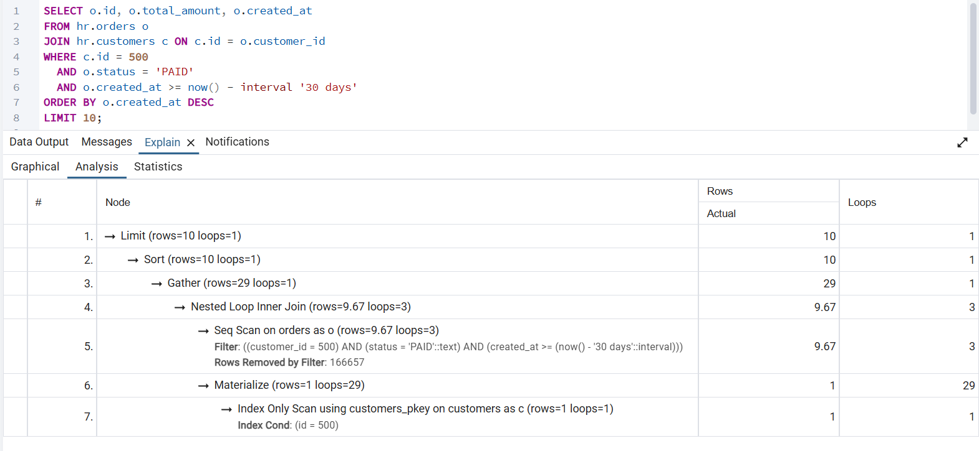
Query Performance Fundamentals
EXPLAIN ANALYZE :
Issue | Why Bad
Seq Scan on orders | Scans 500K rows
Filter instead of Index Cond | Index not used
Slow response | Page load issue
Notes:
10

Slide 11
Query Performance Fundamentals
Fix: Proper Composite Index:
Why Composite?
Query filters on:
  customer_id
  Status
  created_at
  uses ORDER BY created_at DESC
CREATE INDEX idx_orders_customer_status_date
ON hr.orders (customer_id, status, created_at DESC);
Notes:
11

Slide 12
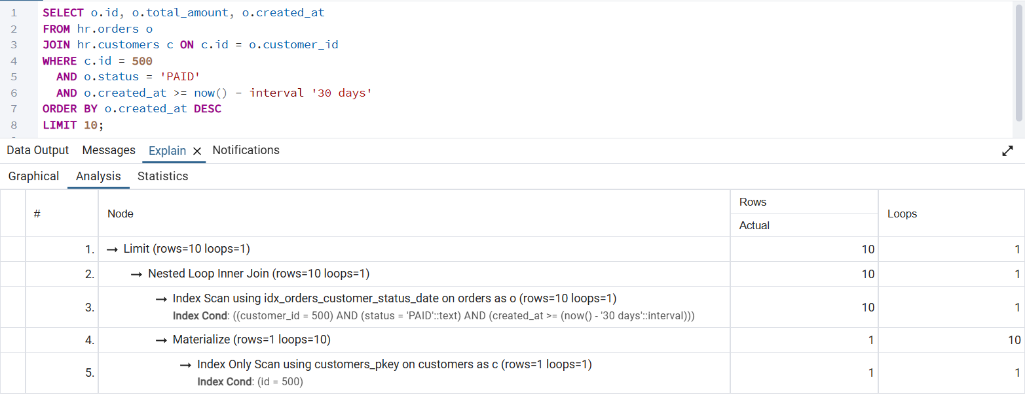
Query Performance Fundamentals
EXPLAIN PLAN (After Fix)
Metric | Before | After
Scan Type | Seq Scan | Index Scan
Rows scanned | 500,000 | ~20
Execution time | 950 ms | 18 ms
User impact | Slow page | Instant load
Notes:
12

Slide 13
Query Performance Fundamentals
Step-by-Step Optimization Flow
EXPLAIN ANALYZE
Find highest actual time
Compare estimated vs actual rows
Check scan type
Add/adjust index
Re-run EXPLAIN
Notes:
13

Slide 14
EXPLAIN vs EXPLAIN ANALYZE
Feature | EXPLAIN | EXPLAIN ANALYZE
Executes query | ❌ | ✅
Shows actual time | ❌ | ✅
Shows actual rows | ❌ | ✅
Safe on prod | ✅ | ⚠️ (careful)
Finds real bottlenecks | ❌ | ✅
Notes:
14

Slide 15
Common Query Anti-Patterns & Optimized Rewrites
Anti-Pattern | ❌ Bad Query | ✅ Optimized Rewrite | Why It’s Better
SELECT * | SELECT * FROM orders; | SELECT id, total_amount FROM orders; | Less I/O, faster, enables index-only scans
Function in WHERE | WHERE LOWER(email) = 'a@b.com' | WHERE email = 'a@b.com' or functional index | Allows index usage
DATE() on timestamp | WHERE DATE(created_at) = '2025-01-01' | WHERE created_at >= '2025-01-01' AND created_at < '2025-01-02' | Index-friendly range scan
IN (SELECT) | WHERE id IN (SELECT user_id FROM users) | JOIN users u ON u.id = o.user_id | Better planner optimization
Notes:
15

Slide 16
Common Query Anti-Patterns & Optimized Rewrites
Anti-Pattern | ❌ Bad Query | ✅ Optimized Rewrite | Why It’s Better
NOT IN with NULLs | WHERE id NOT IN (SELECT id FROM banned) | WHERE NOT EXISTS (...) | Correct logic + faster
OFFSET pagination | LIMIT 10 OFFSET 100000 | Keyset pagination | Avoids scanning skipped rows
Too many ORs | status='A' OR status='B' | status IN ('A','B') | Better index usage
Correlated subquery | Subquery per row | JOIN + GROUP BY | Eliminates repeated execution
Over-indexing | Index every column | Composite/partial indexes | Faster writes, less storage
Notes:
16

Slide 17
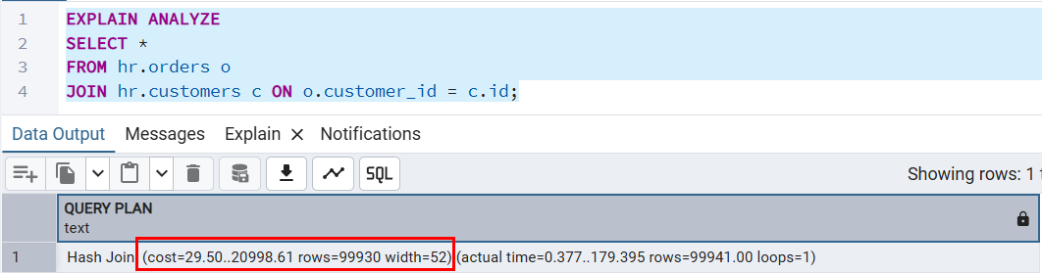
Cost Estimation
PostgreSQL cost estimation is the query planner's way to predict query execution time, using arbitrary "cost units" based on disk fetches, not actual milliseconds, broken down into Startup Cost (first row) and Total Cost (all rows).
Part | Meaning
29.50 | Startup cost
20998.61 | Total cost
rows=99930 | Estimated rows
width=52 | Average row size (bytes)
Notes:
17

Slide 18
Join Strategies
PostgreSQL uses three primary internal join strategies (algorithms) to combine data from multiple tables: Nested Loop Join, Hash Join, and Merge Join. The query planner automatically selects the most efficient strategy based on factors like table size, indexes, and data distribution, which can be inspected using the EXPLAIN command.
Nested Loop Join: This is the simplest strategy, functioning like nested for loops. PostgreSQL iterates through every row of the first (outer) table, and for each of those rows, it scans the second (inner) table to find a match.
Hash Join: This strategy builds an in-memory hash table for one of the tables (usually the smaller one) using the join key(s). It then scans the second table and "probes" the hash table to find matching rows.
Merge Join: This algorithm requires both input tables to be sorted on the join key(s) first. Once sorted, it merges the two tables in a single pass, comparing rows in parallel to find matches.
Notes:
18

Slide 19
Backup & Restore Database
PostgreSQL backup & restore involves using tools like pg_dump (backup) and psql/pg_restore (restore) to create logical copies (SQL scripts or archives) or leveraging physical backups for point-in-time recovery, with options for plain text, custom (compressed, parallelizable), or directory formats for flexibility, crucial for data safety against errors or failures, often automated or managed via GUIs like pgAdmin.
Key Tools & Concepts
pg_dump: Creates a database backup (logical), outputting SQL commands or archive files.
pg_restore: Restores from pg_dump's custom, directory, or tar formats, supporting selective restores and parallel processing.
psql: Executes plain SQL script backups or restores them.
Notes:
19

Slide 20
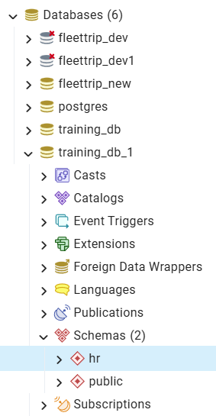
Backup & Restore Database
Notes:
20

Slide 21
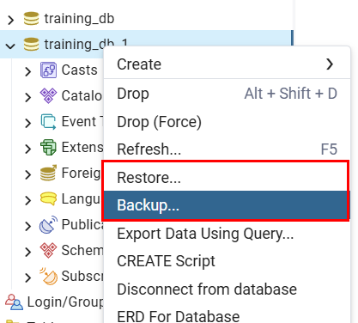
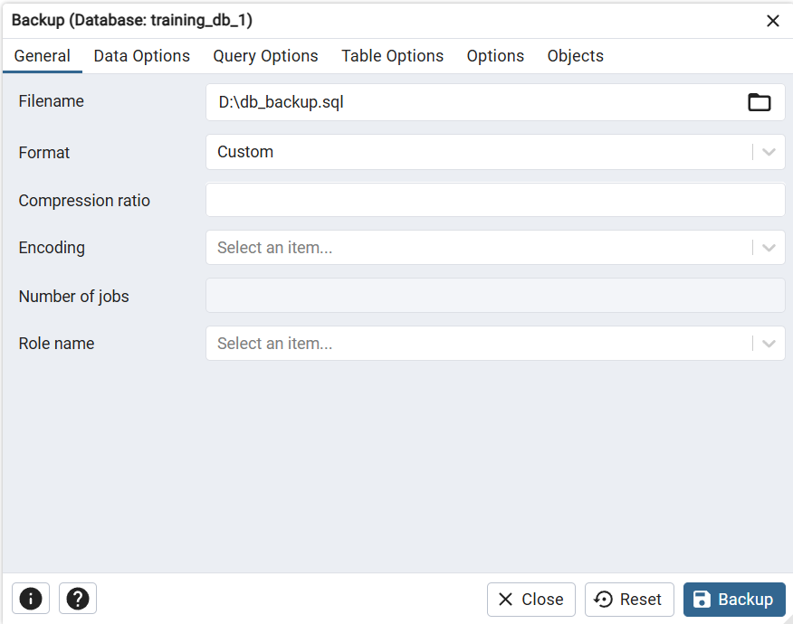
Backup & Restore Database
Notes:
21

Slide 22
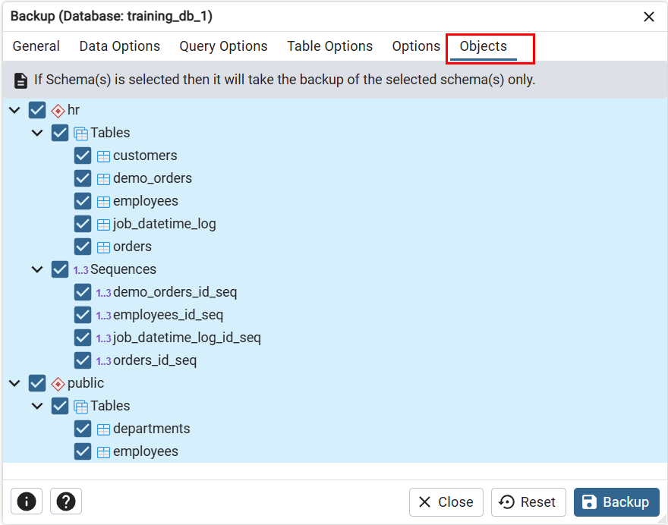
Backup & Restore Database
Notes:
22

Slide 23
Security - Roles, GRANT & REVOKE
PostgreSQL manages database access permissions using the concept of roles, which can function as either a database user or a group of users. Roles are central to the security model, controlling who can connect to the database and what actions they can perform on database objects.
Core Concepts of Roles
User vs. Group: A role with the LOGIN attribute can connect to the database and act as a user. A role without the LOGIN attribute acts like a group, a container for privileges that can be assigned to login roles.
Privileges: Permissions (e.g., SELECT, INSERT, UPDATE, DELETE) define what a role can do on specific database objects (tables, schemas, functions, etc.). These are managed using the GRANT and REVOKE commands.
Inheritance: Roles can inherit privileges from other roles. By default, roles have the INHERIT attribute, meaning they automatically gain the permissions of any role they are a member of. The NOINHERIT attribute can be used to require a user to explicitly use SET ROLE to assume those privileges temporarily.
Notes:
23

Slide 24

Security - Roles, GRANT & REVOKE
How PostgreSQL Uses Roles Internally?
PostgreSQL simplifies its permission model by merging the concepts of users and groups into roles. When you create a user, you’re actually creating a role with the ability to log in.
Here, john is a role with login privileges — in common terms, a user. The readonly role is a group of privileges that can be assigned to multiple users.
Notes:
24

Slide 25

Security - Roles, GRANT & REVOKE
Assigning Roles to Users
One of PostgreSQL’s most powerful features is its role-based privilege inheritance. You can assign roles to other roles, effectively building a hierarchy of permissions.
Now, john inherits all the privileges of the readonly role, making permission management scalable and efficient.
Notes:
25

Slide 26
Security - Roles, GRANT & REVOKE
Why Roles are a Best Practice
Centralized Permission Management: Instead of assigning individual privileges to each user, you define roles for various job functions or permission sets.
Simpler Administration: Adding or removing a user’s access becomes as simple as granting or revoking roles.
Scalability: As your database grows, role-based permissions make it easier to onboard new users or adjust permissions without disrupting other accounts.
Notes:
26

Slide 27
Security - Roles, GRANT & REVOKE
What is a PostgreSQL User?
A PostgreSQL user is essentially a role that has permission to log in to the database server. This means it can authenticate using a username and password and then perform operations as permitted by its privileges.
Think of a user as:
A database login identity (for developers, apps, admins)
A role with the LOGIN attribute
Creating a User:
You can create a new user with a simple SQL command using the CREATE USER statement:
CREATE USER myuser WITH PASSWORD 'mypassword';
Notes:
27

Slide 28
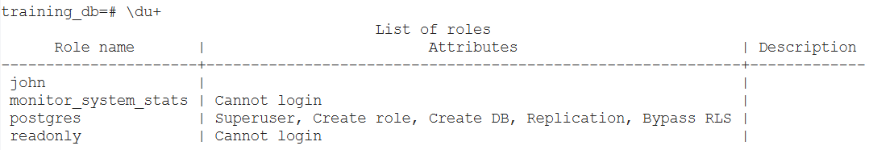
Security - Roles, GRANT & REVOKE
To see the list of all users (and other roles), you can use the following command in psql: \du+
Dropping a User: If a user is no longer needed, you can remove them from the system: DROP USER myuser;
However, note:
You cannot drop a user if they own any database objects (tables, schemas, etc.).
You may need to reassign ownership or drop dependent objects first.
REASSIGN OWNED BY myuser TO another_user;
DROP OWNED BY myuser;
DROP USER myuser;
Notes:
28

Slide 29
Security - Roles, GRANT & REVOKE
What is a Role?
A role in PostgreSQL is a flexible concept that can act as:
A user (a role with login capability)
A group (a role without login, used to collect permissions)
Or both
The real power of roles lies in their ability to inherit privileges from other roles, which creates a clean and scalable access control hierarchy.
Creating a Role:
CREATE ROLE myrole;
By default, this role cannot log in. It’s a placeholder for privileges, designed to be granted to users or other roles.
You can think of this like creating a security group in your system — it doesn’t do anything by itself but becomes powerful when connected to users.
Notes:
29

Slide 30
Security - Roles, GRANT & REVOKE
Granting Privileges to Roles: Once you create a role, you can grant specific database object privileges to it. For example:
GRANT SELECT, INSERT, UPDATE, DELETE ON customers TO myrole;
This command gives the myrole role permission to perform all common operations on the customers table. You can repeat this for other tables or specific columns if needed.
Roles allow you to centralize permission logic — update a role, and all users assigned to it instantly get updated access.
Notes:
30

Slide 31
Security - Roles, GRANT & REVOKE
Assigning Roles to Users: Once a role is configured with the desired privileges, you can assign it to users.
CREATE USER trn_user WITH PASSWORD 'password1';
GRANT myrole TO trn_user;
Here’s what happens:
trn_user becomes a PostgreSQL user.
By granting myrole to trn_user , the user now inherits all the privileges assigned to myrole.
This inheritance is immediate and dynamic — any future changes to myrole will automatically apply to trn_user.
Notes:
31

Slide 32
Security - Example Scenario: E-Commerce Access Levels
Assigning Roles to Users: Once a role is configured with the desired privileges, you can assign it to users.
CREATE USER trn_user WITH PASSWORD 'password1';
GRANT myrole TO trn_user;
Here’s what happens:
trn_user becomes a PostgreSQL user.
By granting myrole to trn_user , the user now inherits all the privileges assigned to myrole.
This inheritance is immediate and dynamic — any future changes to myrole will automatically apply to trn_user.
Notes:
32

Slide 33
Thank You
THANK YOU
ANY QUESTIONS ?
Notes:
33

